Slide 1
UNIT FOUR
INTRODUCTION TO COMP. PROG. AND ALGORITHMS

Slide 2
Chapter Outline
What is computer programming
Reasons to study programming
Types and usage of computer languages
Programming paradigms
Procedural programming
Functional programming
Object-oriented Programming
Algorithm Representation and Data structure
Introduction to flow chart and pseudo code
How to write a pseudo code and draw a flow chart for a given algorithm
Translating algorithms to programming languages
Definition of data structures
Role of data structures in writing programs
Algorithms Vs Data Structure

Slide 3
4.1 What is Computer Programming
Computers can do amazing things, from basic laptops capable of simple word processing and spreadsheet functions to incredibly complex supercomputers completing millions of financial transactions a day and controlling the infrastructure that makes modern life possible.
But no computer can do anything until a computer programmer tells it to behave in specific ways.
That’s what computer programming is all about.
At its most basic, computer programming is little more than a set of instructions to facilitate specific actions.
Based on the requirements or purposes of these instructions, computer programming can be as simple as adding two numbers.

Slide 4
It can also be as complex as reading data from temperature sensors to adjust a thermostat, sorting data to complete intricate scheduling or critical reports or taking players through multi-layered worlds and challenges in games.
Computer programmers use specialized languages to communicate with computers, applications and other systems to get computers and computer networks to perform a set of specific tasks.
Computer programming is the process of writing code to facilitate specific actions in a computer, application or software program, and instructs them on how to perform.
Computer programmers are professionals that create instructions for a computer to execute by writing and testing code that enables applications and software programs to operate successfully.

Slide 5
4.2 Reasons to study Programming
1. Grow in your current job
Programming knowledge does not only benefit someone who works in computer science or related fields.
For example, people who work in marketing, design, sales and customer relations for technology products can use programming training to grow their skill set at work.
Marketing requires data collection and analysis of customer demographics and sales trends to guide advertising strategies, and designers with programming skills can create digital advertisements.
People who work in customer-facing positions can use their programming knowledge to assist with queries about technical issues.

Slide 6
2. Enhance your marketability for a new job
Programming skills, allows you to have increased flexibility in the job market.
Programming skills can often help enhance your resume in comparison to other candidates.
In cases where the job you're applying for doesn't require programming, you can still use your skills to suggest different ways you can bring value to your prospective employer and demonstrate your dedication to self-improvement.
If you want to work in technology, your coding skill set may be sufficient to get a job without a bachelor's degree.
You can enhance your resume even without a degree by earning certificates or diplomas

Slide 7
3. Improve your performance as an employee or leader
With your programming knowledge and skills, you could have a general idea of the challenges and time required to complete many IT and coding-related tasks.
As an employee or manager, this knowledge could allow you to communicate more easily with technical support staff, your website development team or other teams working with computers.
Compared to someone who does not have any programming knowledge, you could potentially better predict how long a given task might take.
With this understanding, you could try to set goals and deadlines with a realistic time frame.

Slide 8
4. Increase your income
In a non-programming job, your programming skills could increase the range of tasks you can perform for your employer.
Doing additional and varied work can increase your value as an employee, which you could use to negotiate for a higher salary.
You can also potentially leverage your skills and value to broaden your job title or seek a promotion.
By having more credentials than other employees or candidates, you might be able to pursue a higher starting salary at a new job as well.
5. Work from home
Because programmers use computers for their work, you might have the opportunity to work from home.
Many programming positions allow for remote work.

Slide 9
Even if your primary job isn't programming, you may be able to devote some period of your workweek to coding and negotiate to do that work from home.
Another benefit of working from a laptop or home computer is that you might be able to change job locations without affecting your commute or needing to move to a new house.
6. Improve your efficiency
With programming skills, you can potentially design applications that allow you to be a more efficient employee.
You can write code to automate processes that you do regularly, allowing your computer to work in the background while you focus on tasks that require human input.
You can also develop apps or websites that any potentially interested customers can access or download.

Slide 10
This scalability can potentially enhance your reach compared to physical stores or advertisements, which require customers to be in specific physical locations.
7. Start your own business
Your programming skills can be helpful if you want to start your own business.
You can work as a freelance programmer or use your coding skills to support any other business you start.
For example, you can build and customize your website or run an online storefront without hiring a website designer.
As a freelancer, you can design and run websites for others, create independent applications or sell training courses or one-on-one mentorships to other people who want to learn to code.

Slide 11
8. Work abroad
Because programming skills are helpful internationally, you can consider trying to live and work abroad as a programmer.
You might have an easier time securing work in a foreign company compared to someone without programming knowledge.
You could work remotely for a company in your home country or as a freelancer while spending time abroad.
9. Learn with your family
Coding is an increasingly valuable skill for young professionals.
By studying programming at home, you can potentially engage your family members, such as your children, in the learning process by inviting them to join you.
As a family, you can go through learning about, creating and testing codes together.

Slide 12
Learning to program together can allow you to bond with your family members and provide them with training that could benefit them in the future.
10. Improve your understanding of the world
Because computers run much of the modern world, by developing programming skills, you can better understand how many things work around you.
For example, you might be able to keep up with developments in computing and automation and advise friends and family about new technologies that interest them or with which they need assistance.
If you have children, you might better understand the applications and online teaching tools they use in school and help them navigate those technologies more efficiently.

Slide 13
11. Develop problem-solving skills
Coding relies fundamentally on problem-solving.
Because there are multiple approaches to writing code for a given situation, learning programming can help you develop your problem-solving skills as you think and work through different solutions.
The flexibility inherent in coding can help you practice looking at a problem from many perspectives and generating several possible answers.
Creative problem-solving is a skill that can transfer to other aspects of your work and daily life.
12. Improve your logic and reasoning skills
Programming requires you to write logical code with a predictable cause-and-effect relationship to ensure that the result is reliable and orderly.

Slide 14
You learn how to find places where you have accidentally inserted problems into the code and how to fix them.
Identifying these issues requires you to break down a piece of code into smaller parts and consider the code as a whole as well.
This type of logical thinking can be helpful in other real-world situations.
13. Improve your attention to detail
Something as small as a missing punctuation mark can disrupt a piece of code.
Learning to code could help you develop your attention to detail because it requires you to look quickly and methodically for these potential errors.
You can also practice avoiding making these mistakes in the first place.

Slide 15
14. Build perseverance
Because code is dependent on accuracy, you may experience incorrect coding.
When errors occur, you usually have to think about possible sources and look for and identify them to find ways to correct them.
Although this process can take time, it can help teach you not to give up during difficult situations.
15. Grow your creativity
Programming has the potential to be a very creative field.
You can generate code from nothing, starting with only your goals for the final product.
Due to the open nature of coding, you can experiment with various codes to produce the most efficient one while still achieving your goals.

Slide 16
You can also use your programming skills to enhance your other creative pursuits, for example, by building games.
16. Develop your communication skills
When you work on coding projects with others, you usually have to communicate with people with varying goals and levels of training.
If you work primarily in programming, you may need to explain the inner workings of your job to others in a way that they can understand without much education in the field.
If you're a freelancer designing a website for someone else's business, you might need to help them determine what is realistic for the needs of their business and make sure you clearly understand their needs and goals.
Suppose you're working as part of a team responding to comments from the public, such as fixing bugs in an application.
In that case, you probably need to communicate both with your team and your customers in a clear, professional and solution-focused way.

Slide 17
17. Join a community
When you learn to program, you can communicate with other people who share your skills.
You can join professional organizations and attend conferences or local groups to work on projects together.
There are also many online communities for people interested in programming so that you can communicate with professionals from many different backgrounds, skill levels and cultures about your shared interest.
18. Learn new languages more easily
Thinking in terms of language independent concepts (e.g. types, sequencing, iteration, selection, recursion, concurrency, subroutines, parameter passing, naming, scope, abstraction, inheritance, composition, binding, etc.) rather than in one particular language’s syntactic constructs enables you to adapt to any programming environment.

Slide 18
4.3 What is Programming Languages
What is Language?
Language is a mode of communication that is used to share ideas, opinions with each other.
For example, if we want to teach someone, we need a language that is understandable by both communicators.
A programming language is a way for programmers (developers) to communicate with computers.
Programming languages consist of a set of rules that allows string values to be converted into various ways of generating machine code.
A programming language is a notational system for describing computation in machine-readable and human-readable form.
A programming language is mainly used to develop desktop applications, websites, and mobile applications.

Slide 19
Programming language is the way by which programmers communicate with computers.
They are mostly a set of instructions that they give to the computer for completing a certain task.
They are essential for developing applications and websites.
Programming language is just not one language.
Like humans have many languages to communicate, computers also have many but the common element between them is binary.
There are thousands of programming languages in the world now due to technology evolution and innovation.
Programmers can choose which one they want according to the kind of job they need to complete

Slide 20
4.4 Types and usage of Computer Languages
There are basically two types of computer programming languages given below:
Low level language
High level language
1. Low Level Languages
The programming languages that are very close to machine code (0s and 1s) are called low-level programming languages.
The program instructions written in these languages are in binary form.
The examples of low-level languages are:
Machine Language
Assembly Language

Slide 21
1. Machine Language
The instruction is in binary form, which can be directly understood by the computer (CPU) without translating them, is called a machine language or machine code.
Machine language is also known as first generation of programming language.
Machine language is the fundamental language of the computer and the program instructions in this language is in the binary form (that is 0's and 1's).
This language is different for different computers.
It is not easy to learn the machine language.
Advantage of Machine Language
The program of machine language runs very fast because no translation program is required for the CPU.

Slide 22
Limitations of Machine Language:
Machine Dependent
The internal design of every computer is different from every other type of computer, machine language also differs from one computer to another.
Hence, after becoming proficient in the machine language of one type of computer, if a company decides to change to another type, then its programmer will have to learn a new machine language and would have to rewrite all existing program.
Difficult to Modify or Debugging
It is difficult to correct or modify this language.
Checking machine instructions to locate errors is very difficult and time consuming.
Difficult to Program
A computer executes machine language program directly and efficiently, it is difficult to program in machine language.
A machine language programming must be knowledgeable about the hardware structure of the computer.

Slide 23
2. Assembly Language
It is another low-level programming language because the program instructions written in this language are close to machine language.
Assembly language is also known as second generation of programming language.
With assembly language, a programmer writes instructions using symbolic (mnemonics) instruction code instead of binary codes.
Symbolic codes are meaningful abbreviations such as:
ADD to used for addition operation,
SUB is used for substation operation,
MUL for multiply operation and so on.
Therefore this language is also called the low-level symbolic language.
Assembly language provides facilities for controlling the hardware.

Slide 24
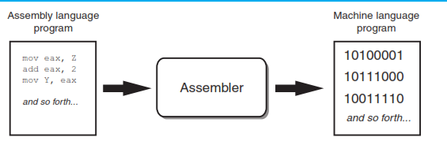
The CPU only understands machine language, so a special program known as an assembler is used to translate an assembly language program to a machine language program.
This process is shown in Figure 3-1. The machine language program that is created by the assembler can then be executed by the CPU.
Figure 4-1 An assembler translates an assembly language program to a machine language program

Slide 25
Advantage of Assembly Language
Easy to understand and use
Due to the use of mnemonic instead of numeric codes and symbolic names for data location instead of numeric addresses, it is much easier to understand and use in contrast with machine language.
Easier to locate and correct errors
The programmers need not to keep track of storage location of the data and instruction, fewer errors are made while writing programs in assembly language and those that are made, are easier to find and correct.
Easy to modify
Assembly language are easier to understand, it is easier to locate, correct and modify instruction of an assembly language program.
Efficiency of machine language
An assembly language program will be just as long as the resulting machine language program.
Hence, leaving out the translation time required by the assembler, the actual execution time for an assembly language program and its equivalent machine language program.

Slide 26
Limitations of Assembly Languages
Machine dependent
Each instructions of assembly language program is translated into exactly one machine language instruction, an assembly language programs are dependent on machine language.
Knowledge of hardware required
It is machine dependent programming language.
An assembly language programmer must have a good knowledge of characteristics and logical structure of his/her computer to write a good assembly language computer code.
Machine level coding
Assembly language instruction is substituted for one machine language instruction. Hence like machine language programs, write assembly language program is also time consuming and difficult

Slide 27
NOTE:
There are many different versions of assembly language.
It was mentioned earlier that each brand of CPU has its own machine language instruction set.
Each brand of CPU typically has its own assembly language as well.
Assembly language programs cannot be executed by the CPU, however.

Slide 28
3. High Level Languages
It is a programming languages that are close to human languages (like English languages or mathematical notations).
The examples of high-level languages are:
Fortran, COBOL
Basic
Pascal
C and C++
Java
The high level languages are similar to English language or mathematical notations.
The program instructions are written using English like statements and mathematical notations or expressions, for example print, input, z=(x+y) and etc.

Slide 29
But each high level language has its own rule and grammar for writing program instructions.
These rules are called syntax of the language.
Because the CPU understands only machine language instructions, programs that are written in a high-level language must be translated into machine code before to run it.
Depending on the language that a program has been written in, the programmer will use either a compiler or an interpreter to make the translation.
A compiler is a program that translates a high-level language program into a separate machine language program.
The machine language program can then be executed any time it is needed.
As shown in the following figure (Figure 3-2) , compiling and executing are two different processes.

Slide 30
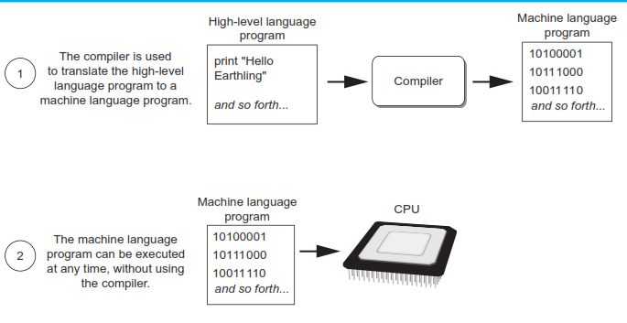
Figure 4-2 Compiling a high-level program and executing it

Slide 31
The Python language uses an interpreter, which is a program that both translates and executes the instructions in a high-level language program.
As the interpreter reads each individual instruction in the program, it converts it to machine language instructions and then immediately executes them.
This process repeats for every instruction in the program.
This process is illustrated in Figure 4-3 on the next slide.
Because interpreters combine translation and execution, they typically do not create separate machine language programs.

Slide 32
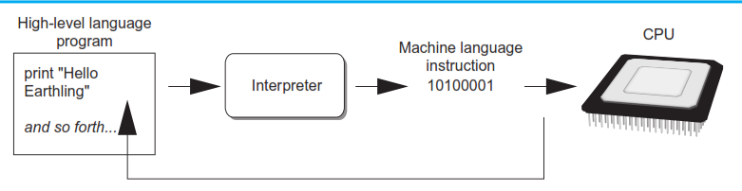
Figure 4-3 Executing a high-level program with an interpreter
The interpreter translates each high-level instruction to its equivalent machine language instructions and immediately executes them.
This process is repeated for each high-level instruction.

Slide 33
The statements that a programmer writes in a high-level language are called source code, or simply code.
Typically, the programmer types a program’s code into a text editor and then saves the code in a file on the computer’s disk.
Next, the programmer uses a compiler to translate the code into a machine language program, or an interpreter to translate and execute the code.
If the code contains a syntax error, however, it cannot be translated (or compiled).
A syntax error is a mistake such as a misspelled key word, a missing punctuation character, or the incorrect use of an operator.
When this happens the compiler or interpreter displays an error message indicating that the program contains a syntax error.

Slide 34
The high level programming languages are further divided into:
Procedural languages
Non procedural languages
Object oriented programming languages
Advantages of High Level Languages
Easy to learn
The high level languages are very easy to learn than low level languages.
The statements written for the program are similar to English-like statements or mathematical expression or notation.
Easy to understand
The program written in high level language by one programmer can easily be understood by another because the program instructions are similar to the English language.
Easy to write program –
In high level language, a new program can easily be written in a very short time. The larger and complicated software can be developed in few days or months.
Easy to detect and remove errors –
The errors in a program can be easily detected and removed. mostly the errors are occurred during the compilation of new program.

Slide 35
Built-in library functions
Each high level language provides a large number of built-in functions or procedures that can be used to perform specific task during designing of new programs.
In this way, a large amount of time of programmer is saved.
Machine Independence
Program written in high level language is machine independent.
It means that a program written in one type of computer can be executed on another type of computer.

Slide 36
Limitation of High Level Language
Low efficiency
A program written in high level languages has lower efficiency than one written in a machine/assembly language to do the same job.
That is, program written in high level languages result in multiple machine language instruction that may not be optimize, taking more time to execute and requiring more memory space.
Less flexibility
High level languages are less flexible than assembly languages because they do not normally have instructions or mechanism to control a computer's CPU, memory and register.

Slide 37
Activity
A CPU understands instructions that are written only in what language?
A program has to be copied into what type of memory each time the CPU executes it?
When a CPU executes the instructions in a program, it is engaged in what process?
What is assembly language?
What type of programming language allows you to create powerful and complex programs without knowing how the CPU works?
Each language has a set of rules that must be strictly followed when writing a program. What is this set of rules called?
What do you call a program that translates a high-level language program into a separate machine language program?
What do you call a program that both translates and executes the instructions in a high-level language program?
What type of mistake is usually caused by a misspelled key word, a missing punctuation character, or the incorrect use of an operator?

Slide 38
4.5 Programming Paradigms
A programming paradigm is a style, or “way,” of programming.
Some languages make it easy to write in some paradigms but not others.
Programming paradigms are different ways or styles in which a given program or programming language can be organized.
Each paradigm consists of certain structures, features, and opinions about how common programming problems should be tackled.
The question of why are there many different programming paradigms is similar to why are there many programming languages.
Certain paradigms are better suited for certain types of problems, so it makes sense to use different paradigms for different kinds of projects.
Programming paradigms are not languages or tools.
You can't "build" anything with a paradigm.

Slide 39
They're more like a set of ideals and guidelines that many people have agreed on, followed, and expanded upon.
The following are the common programming paradigms that programmers use for different projects:
Procedural Programming
Functional Programming
Object Oriented Programming
1. Procedural Programming
This paradigm consists of set of procedures which is referred as function, method or subroutines.
Each function performs specific operation.
The function consists of group of computational steps that directs the computer to perform specific operation.

Slide 40
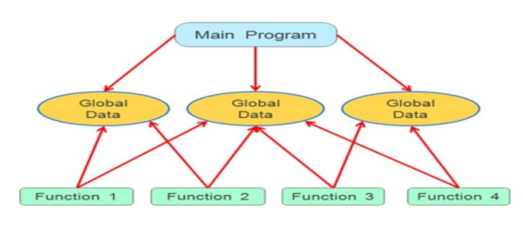
The function once defined can be called many times in the program to repeat the same operation.
The programmer can either use standard library functions or create library of user defined functions.
Examples of Procedural Programming Paradigm:
FORTRAN, COBOL, C, C++, Ruby, PHP, JavaScript, Python, Pascal, ColdFusio.

Slide 41
Features of Procedural Code
Procedural Programming is excellent for general-purpose programming
The coded simplicity along with ease of implementation of compilers and interpreters
A large variety of books and online course material available on tested algorithms, making it easier to learn.
The source code is portable
The code can be reused in different parts of the program, without the need to copy it
The program flow can be tracked easily as it has a top-down approach.

Slide 42
2. Functional Programming
As it name suggests, functional programming is mathematical functions.
It attempts to solve the problem by composing mathematical functions as a program components.
The computer program is created with the application and composing the mathematical functions.
The following are examples of Functional Programming:
Common Lisp
Scheme
Haskell
Julia
Nimrod

Slide 43
Functional programming is a programming paradigm where you have a style of building the structure and elements of computer programs.
Here you treat computation as an evaluation of mathematical functions and you avoid changing-state and mutable data.
Functional programming consists only of PURE functions. So, what do you understand by Pure functions?
Pure functions are those which take an argument list as an input and whose output is a return value.
Now you may feel that all functions are pure as any function takes in values and returns a value.
For example, if a function relies on the global variable or class member’s data, then it is not pure.

Slide 44

Features of Functional Paradigm
Pure functions
As seen above, if the input is an array, the output will be a new array and the input array will not be modified.
So in case of pure functions, the output depends only on the input.
Here’s a function in the language Scala that takes values and returns their sum.
The add function caused no side-effects.
It did not alter the input values provided, it used another pure function, the + operator, and returned the sum of the values as the result of the call.
The add function is a pure function.

Slide 45
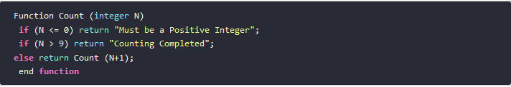
2. Recursion
A recursive function is a function that calls itself during its execution.
This enables the function to repeat itself several times, the result being outputted at the end of each iteration.
Below is an example of a recursive function.
The function Count() above uses recursion to count from any number between 1 and 9, to the number 10.
For example, Count(1) would return 2,3,4,5,6,7,8,9,10. Count(7) would return 8,9,10.

Slide 46
You will note that recursive functions are common in computer science because they allow you to write efficient programs using a minimal amount of code.
The downside is that they can cause infinite loops and other unexpected results if not written properly.
For example, in the example above, the function is terminated if the number is 0 or less or greater than 9.
If proper cases are not included in the function to stop the execution, the recursion will repeat forever, causing the program to crash, or worse yet, hang the entire computer system.
3. Referential transparency
An expression is said to be referentially transparent if it can be replaced with its corresponding value without changing the program's behaviour.

Slide 47
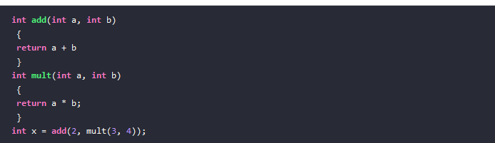
As a result, evaluating a referentially transparent function gives the same value for fixed arguments.
In functional programming, only referentially transparent functions are considered.
They are a lot easier to read and understand.
In this example, the mult method is referentially transparent because any call to it may be replaced with the corresponding return value.
This may be observed by replacing mult(3, 4) with 12:

Slide 48
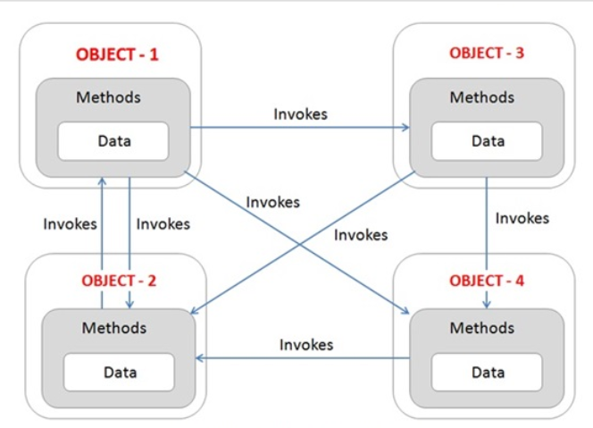
3. Object-oriented Programming
In this paradigm, all real-world entities are represented by Classes.
Objects are instances of classes so each object encapsulates a state and behaviour.
State implies the fields, attributes of the object and behaviour is what you do with the state of the object and they are the methods.
Objects interact with each other by passing messages.

Slide 49
Features of OOP
Encapsulation
This is a fundamental feature of Object-Oriented Programming.
Here you hide unnecessary details in classes and deliver a simple and clear interface for working.
It describes the idea of bundling data and methods that work on that data within one unit.
This concept is also often used to hide the internal representation, or state, of an object from the outside
Inheritance
Inheritance is one of the core concepts of object-oriented programming (OOP) languages.
It is a mechanism where you can derive a class from another class for a hierarchy of classes that share a set of attributes and methods.

Slide 50
It explains how the class hierarchies develop code readability and support to the reuse of functionality.
Data Abstraction
To Data abstraction is the reduction of a particular body of data to a simplified representation of the whole.
Data abstraction is usually the first step in database design.
Polymorphism
Polymorphism is an object-oriented programming concept that refers to the ability of a variable, function or object to take on multiple forms.
Programming languages that have implemented the OO paradigm are: Ruby, Java, C++, Python, Simula(the first OOP language)
Example of a class:

Slide 51
4.6 Programming Development Process
Programming is the process of creating or writing a set of instructions that tell a computer how to perform a task.
Programming can be done using a variety of computer "languages," such as SQL, Java, Python, and C++.
Syntax refers to the spelling and grammar of a programming language.
Computers are inflexible machines that understand what you type only if you type it in the exact form that the computer expects.
The expected form is called the syntax. Program with syntax errors cannot execute.
A logic error (or logical error) is a mistake in a program's source code that results in incorrect or unexpected behavior.
It is a type of runtime error that may simply produce the wrong output or may cause a program to crash while running.
Many different types of programming mistakes can cause logic errors

Slide 52
Generally the programming errors are named as bugs and the process of checking and correcting errors are called Debugging.
Program development is the process of writing or creating or developing application programs.
This is called Program Development Life Cycle (PDLC).
The process containing the five phases or processes of program development:
Analyzing the Problem
Design Algorithm
Coding
Debugging and Testing
Documentation

Slide 53
Problem Analysis
Clear statement of the problem is stated(identified),
Understands the problem and how to solve it.
The programmer must know what is expected of the problem, i.e.
What the program should do or operations to be performed?
Understand the ways of solving the problem
The nature of the output
The input to consider so as to get the output.
The relationship between the input and the expected output
Example: Problem
Calculate Area and Circumference of a Circle

Slide 54
2) Design
is the planning of the solution to the problem.
Planning consists of the process of finding a logical sequence of precise steps to solve the problem.
Such a sequence of steps is called an algorithm.
The three popular methods(tools) used to develop the logic plan are:
Flowcharts
Pseudo code
Top-down chart
These programming tools help the programmer:
To break down a problem into a sequence of small tasks that the computer can perform to solve the problem.

Slide 55
A) Flowcharts
It is one of the programming tools to represent the problem or the task graphically.
The main advantage of using a flowchart to plan a task is that:
It provides a pictorial representation of the task, which makes the logic easier to follow.
It shows every step and how each step is connected to the next.
The major disadvantage with flowcharts is that when a program is very large, the flowcharts may continue for many pages, making them difficult to follow and modify.
The following figure shows the standard symbols used in a flow chart adopted by American National Standards Institute (ANSI):

Slide 56
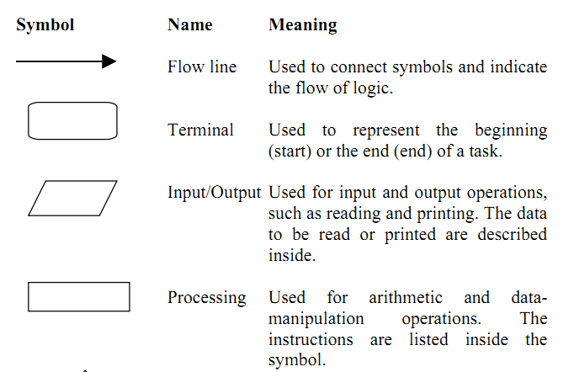

Slide 57
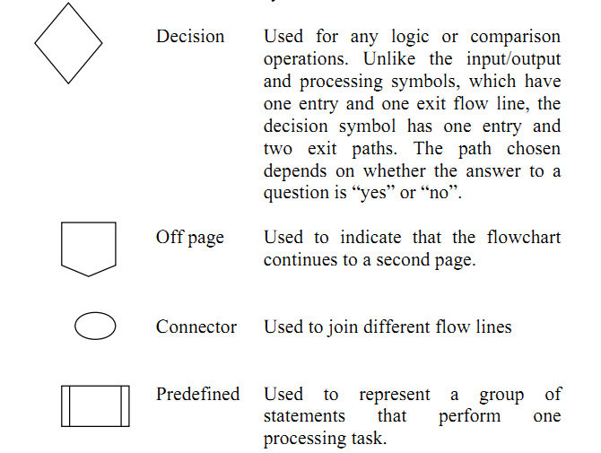
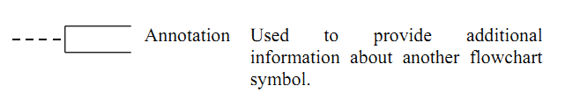
Figure 4.6 : Table of the flowchart symbols adopted by the American National
Standards Institute (ANSI)

Slide 58
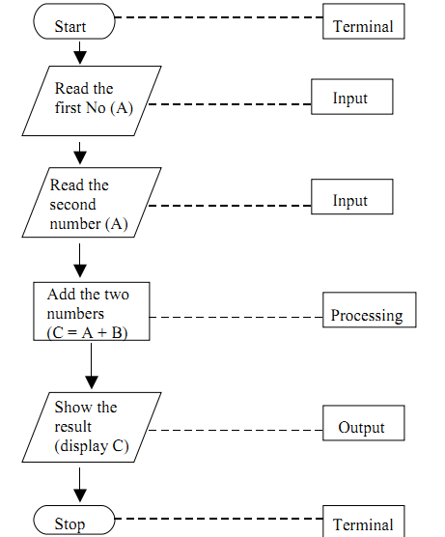
Example- Problem: Draw a flowchart to find the sum of two numbers

Slide 59
B) Pseudo Code
Pseudocode is a method of describing computer algorithms using a combination of natural language and programming language.
It is essentially an intermittent step towards the development of the actual code.
It allows the programmer to formulate their thoughts on the organization and sequence of a computer algorithm without the need for actually following the exact coding syntax.
It is an abbreviated version of an actual computer code.
The geometric symbols used in flowcharts are replaced by English-like statements that outline the process.
As a result, a pseudo code looks more like a computer code than a flowchart does.

Slide 60
The pseudo code allows the programmer to focus on the steps required to solve a problem rather than on how to use the computer language.
When the pseudo code is completed, it can be easily translated into the programming language you select.
The pseudo code has several advantages:
It is compact and probably will not extend for many pages as a flowchart would.
The plan looks like the code to be written and so is preferred by many programmers
Problem: To find the sum and average of two numbers.
Analyze the problem and design the algorithm using psudocode:
The problem analysis is represented by ordinary English expressions as follows .

Slide 61
Problem Analysis:
1. Start
2. Get the first number
3. Get the second number
4. Add the two numbers together
5. Find average of two numbers
5. Show the result
6. Stop
Psudocode program for Sum and Average of two numbers:
Step 1 Start
Step 2 Input A
Step 3 Input B
Step 4 C=(A + B)
Step 5 Print C
Step 6 av=(A+B)/2
Step 7 Print av
Step 8 Stop

Slide 62
Test yourself
Draw a flow chart and write the pseudo code for the problem to determine whether the number is Positive, Negative or Zero.
Use two numbers (a and b). Draw a flow chart and Write a pseudo code program to determine whether the number is smaller or larger than each other.
The perimeter P and Area of a triangle whose sides have lengths a, b and c are given by:
P=a+b+c
Area
Where s=(a+b+c)/2.
Draw a flow chart or write a pseudo code program with input a, b, c and output P and Area.

Slide 63
3) Coding
It is the process of translation of the algorithm into programming language.
Example 2:- Write C++ program for the previous algorithm you design for the problem to calculate sum and average of two numbers
4) Testing and Debugging
is the identification and removal of error in the program if any.
An error in a program is called a bug
Testing is the process of checking if the program is working as expected and finding errors in the program.
Debugging is the process of correcting errors that are found.
5) Documentation
is an organizing of all the material that describes the program for future use or reference.
It consist of:
Detailed description of what the program does and how to use the program.
Statements in the program that are not executed, but point out the purpose of various parts of the program.
Flowchart and pseudo code that were used to construct the program.
Code that is derived from the pseudo cod program or flow chart.

Slide 64
Algorithms Vs Flowcharts
 | Algorithms | Flowcharts
1 | An algorithm is a step-by-step procedure to solve a problem. | A flowchart is a diagram created with different shapes to show the flow of data
2 | Algorithm is complex to understand. | A flowchart is easy
3 | In the algorithm, plain text is used. | In the flowchart, symbols/shapes are used.
4 | The algorithm is easy to debug. | A flowchart is hard to debug.
5 | The algorithm is difficult to construct. | A flowchart is simple to construct.
6 | The algorithm does not follow any rules. | The flowchart follows rules to be constructed.
7 | The algorithm is the pseudo-code for the program. | A flowchart is just a graphical representation of that logic.

Slide 65
4.7 Algorithm Representation and Data Structure
An algorithm is a set of instructions that describes how to solve a problem.
Writing a logical step-by-step method to solve the problem is called the algorithm.
In other words, an algorithm is a procedure for solving problems.
In order to solve a mathematical or computer problem, this is the first step in the process.
An algorithm includes calculations, reasoning, and data processing.
Algorithms can be presented by natural languages, pseudocode, and flowcharts, etc.
Data structures are used to create efficient, clear, and organized programs.
Among the best known data structures are lists and arrays.
This guide introduces and defines data structures and explains why they are important.
It also highlights the most important data structures and clarifies when and how each one can be used.

Slide 66
4.7.1 Data structures
In computer science, a data structure is a format that organizes, manages, and stores data.
For a data structure to be practical, it must be relevant to the task and easy to use.
Programmers should be able to quickly and efficiently store and retrieve data using the structure.
Additionally, the data must be arranged in a sensible way within the context of the program.
A data structure must also support useful and usable algorithms.
Data Structure is a systematic way to organize data in order to use it efficiently.

Slide 67
The following terms are the foundation terms of a data structure.
1. Interface
Each data structure has an interface.
Interface represents the set of operations that a data structure supports.
An interface only provides the list of supported operations, type of parameters they can accept and return type of these operations.
2. Implementation
Implementation provides the internal representation of a data structure.
Implementation also provides the definition of the algorithms used in the operations of the data structure.

Slide 68
4.7.1.1 Characteristics of a Data Structure
Correctness:
Data structure implementation should implement its interface correctly.
Time Complexity:
Running time or the execution time of operations of data structure must be as small as possible.
Space Complexity:
Memory usage of a data structure operation should be as little as possible.

Slide 69
4.7.1.2 Role(Needs) of Data Structures in writing programs
As applications are getting complex and data rich, there are three common problems that applications face now-a-days.
Data Search
Consider an inventory of 1 million(10⁶) items of a store.
If the application is to search an item, it has to search an item in 1 million(10⁶) items every time slowing down the search.
As data grows, search will become slower.
Processor Speed
Processor speed although being very high, falls limited if the data grows to billion records.

Slide 70
Multiple requests
As thousands of users can search data simultaneously on a web server, even the fast server fails while searching the data.
To solve the above-mentioned problems, data structures come to rescue.
Data can be organized in a data structure in such a way that all items may not be required to be searched, and the required data can be searched almost instantly

Slide 71
4.7.2.1 Algorithms
Algorithm is a step-by-step procedure, which defines a set of instructions to be executed in a certain order to get the desired output.
Algorithms are generally created independent of underlying languages, i.e. an algorithm can be implemented in more than one programming language.
From the data structure point of view, following are some important categories of algorithms:
Search − Algorithm to search an item in a data structure.
Sort − Algorithm to sort items in a certain order.
Insert − Algorithm to insert item in a data structure.
Update − Algorithm to update an existing item in a data structure.
Delete − Algorithm to delete an existing item from a data structure.

Slide 72
4.7.2.2 Characteristics of an Algorithm
Not all procedures can be called an algorithm.
An algorithm should have the following characteristics:
Unambiguous−Algorithm should be clear and unambiguous. Each of its steps (or phases), and their inputs/outputs should be clear and must lead to only one meaning.
Input−An algorithm should have 0 or more well-defined inputs.
Output−An algorithm should have 1 or more well-defined outputs, and should match the desired output.
Finiteness−Algorithms must terminate after a finite number of steps.
Feasibility−Should be feasible with the available resources.
Independent−An algorithm should have step-by-step directions, which should be independent of any programming code.

Slide 73
4.7.2.3 How to Write an Algorithm?
There are no well-defined standards for writing algorithms. Rather, it is problem and resource dependent.
Algorithms are never written to support a particular programming code.
As we know that all programming languages share basic code constructs like loops (do, for, while), flow-control (if-else), etc.
These common constructs can be used to write an algorithm.
We write algorithms in a step-by-step manner, but it is not always the case.
Algorithm writing is a process and is executed after the problem domain is well-defined.
That is, we should know the problem domain, for which we are designing a solution.

Slide 74
Example
Problem − Design an algorithm to add two numbers and display the result.
Step 1: START
Step 2: Declare three integers a, b & c
Step 3: Define Values of a & b
Step 4: Add Values of a & b
Step 5: Store output of step for to c
Step 7: Print c
Step 8: STOP

Slide 75
Algorithms tell the programmers how to code the program. Alternatively, the algorithm can be written as −
Step 1- START ADD
Step 2-get values of a & b
Step-3- c<-a + b
Step 4-display c
Step 5-STOP
In design and analysis of algorithms, usually the second method is used to describe an algorithm. It makes it easy for the analyst to analyse the algorithm ignoring all unwanted definitions.
He can observe what operations are being used and how the process is flowing.
Writing step numbers, is optional.
We design an algorithm to get a solution of a given problem. A problem can be solved in more than one ways

Slide 76
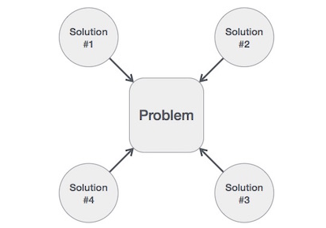
Hence, many solution algorithms can be derived for a given problem.
The next step is to analyse those proposed solution algorithms and implement the best suitable solution.

